Slide 1

April 25, 2024
Determining the fundamental electric charge
By Millikan’s “Oil-Drop” Method
Ryan J Schlimme
Bachelor of Science, Computational Physics, May 2024
Raizen Lab
The University of Texas at Austin
Notes:
Interferometric Acoustic Detection

Slide 2
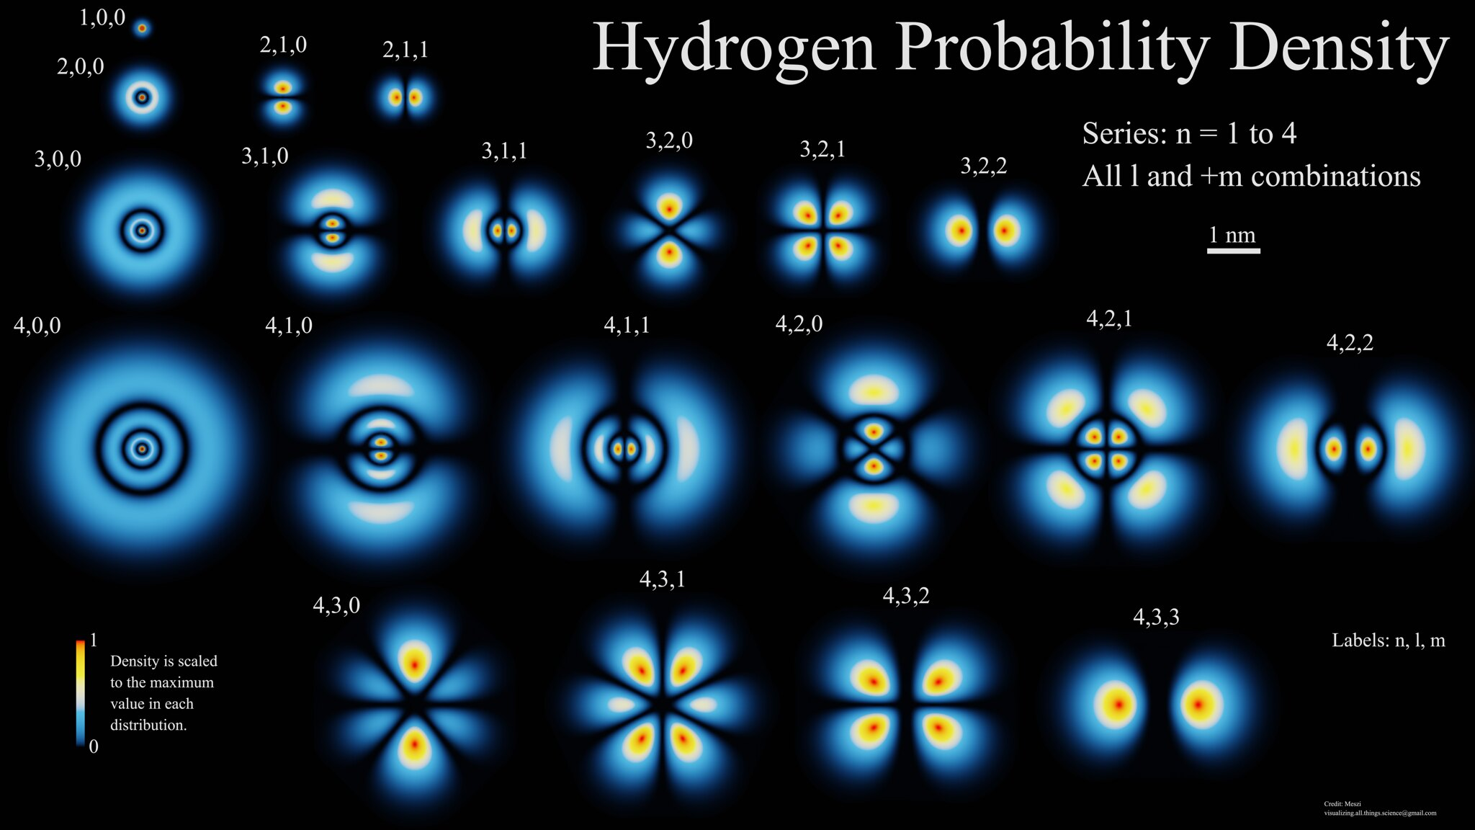
Notes:
Many scientists throughout the 19th century contributed to the formulation of quantized charge
first careful measurement of electron’s charge published by Robert Millikan and Harvey Fletcher in 1911
error of less than 0.3% of current defined value
Millikan’s experimental proof enabled advancements in quantum mechanics throughout the coming decades
In our experiment, we seek to use Millikan’s method to determine the fundamental electric charge

Slide 3

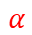
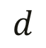
-
Upper Plate
-
Th-232
$$α$$
+
$$d$$
500 V DC
$$F_{e}$$
+
+
Lower Plate

Slide 4



$$F_{f}$$
$$v_{f}$$
$$F_{g}$$

Slide 5
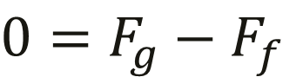

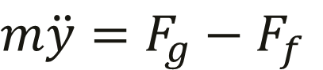
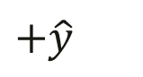

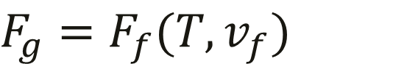

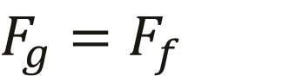
$$m\ddot{y}=F_{g}−F_{f}$$
$$F_{f}$$
$$0=F_{g}−F_{f}$$
$$v_{f}$$
$$F_{g}=F_{f}$$
$$F_{g}$$
$$F_{g}=F_{f}(T,v_{f})$$
$$+\hat{y}$$
Notes:
We define our positive y direction downwards
We balance the forces
At terminal velocity, y double dot is 0
This allows us to say that F_g equals F_f
But in reality our friction model is complicated and relies upon temperature and the terminal velocity among other inputs

Slide 6



$$F_{e}$$
$$v_{r}$$
$$F_{g}$$
$$\tilde{F_{f}}$$

Slide 7

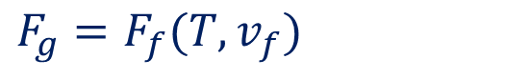

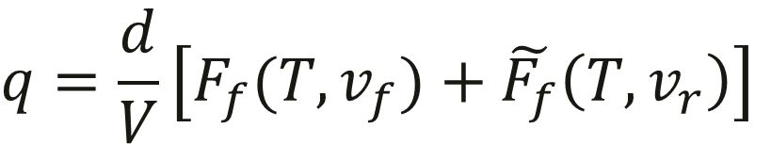
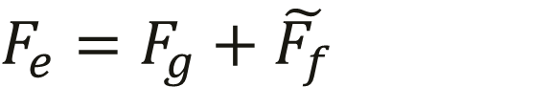
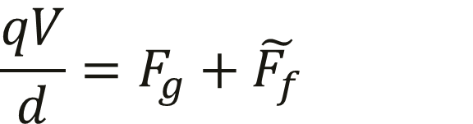
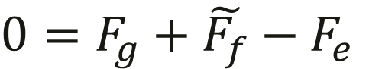

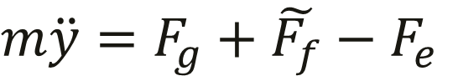

$$m\ddot{y}=F_{g}+\tilde{F_{f}}−F_{e}$$
$$0=F_{g}+\tilde{F_{f}}−F_{e}$$
$$F_{e}$$
$$v_{r}$$
$$F_{e}=F_{g}+\tilde{F_{f}}$$
$$\frac{qV}{d}=F_{g}+\tilde{F_{f}}$$
$$F_{g}$$
$$+\hat{y}$$
$$F_{g}=F_{f}(T,v_{f})$$
$$q=\frac{d}{V}\left[F_{f}(T,v_{f})+\tilde{F_{f}}\left(T, v_{r}\right)\right]$$
$$\tilde{F_{f}}$$
Notes:
We define our positive y direction downwards
We balance the forces
At terminal velocity, y double dot is 0
This allows us to say that F_e equals F_g + F_f
But again our friction model is complicated
The force of gravity is unchanged so we can insert our prior result

Slide 8
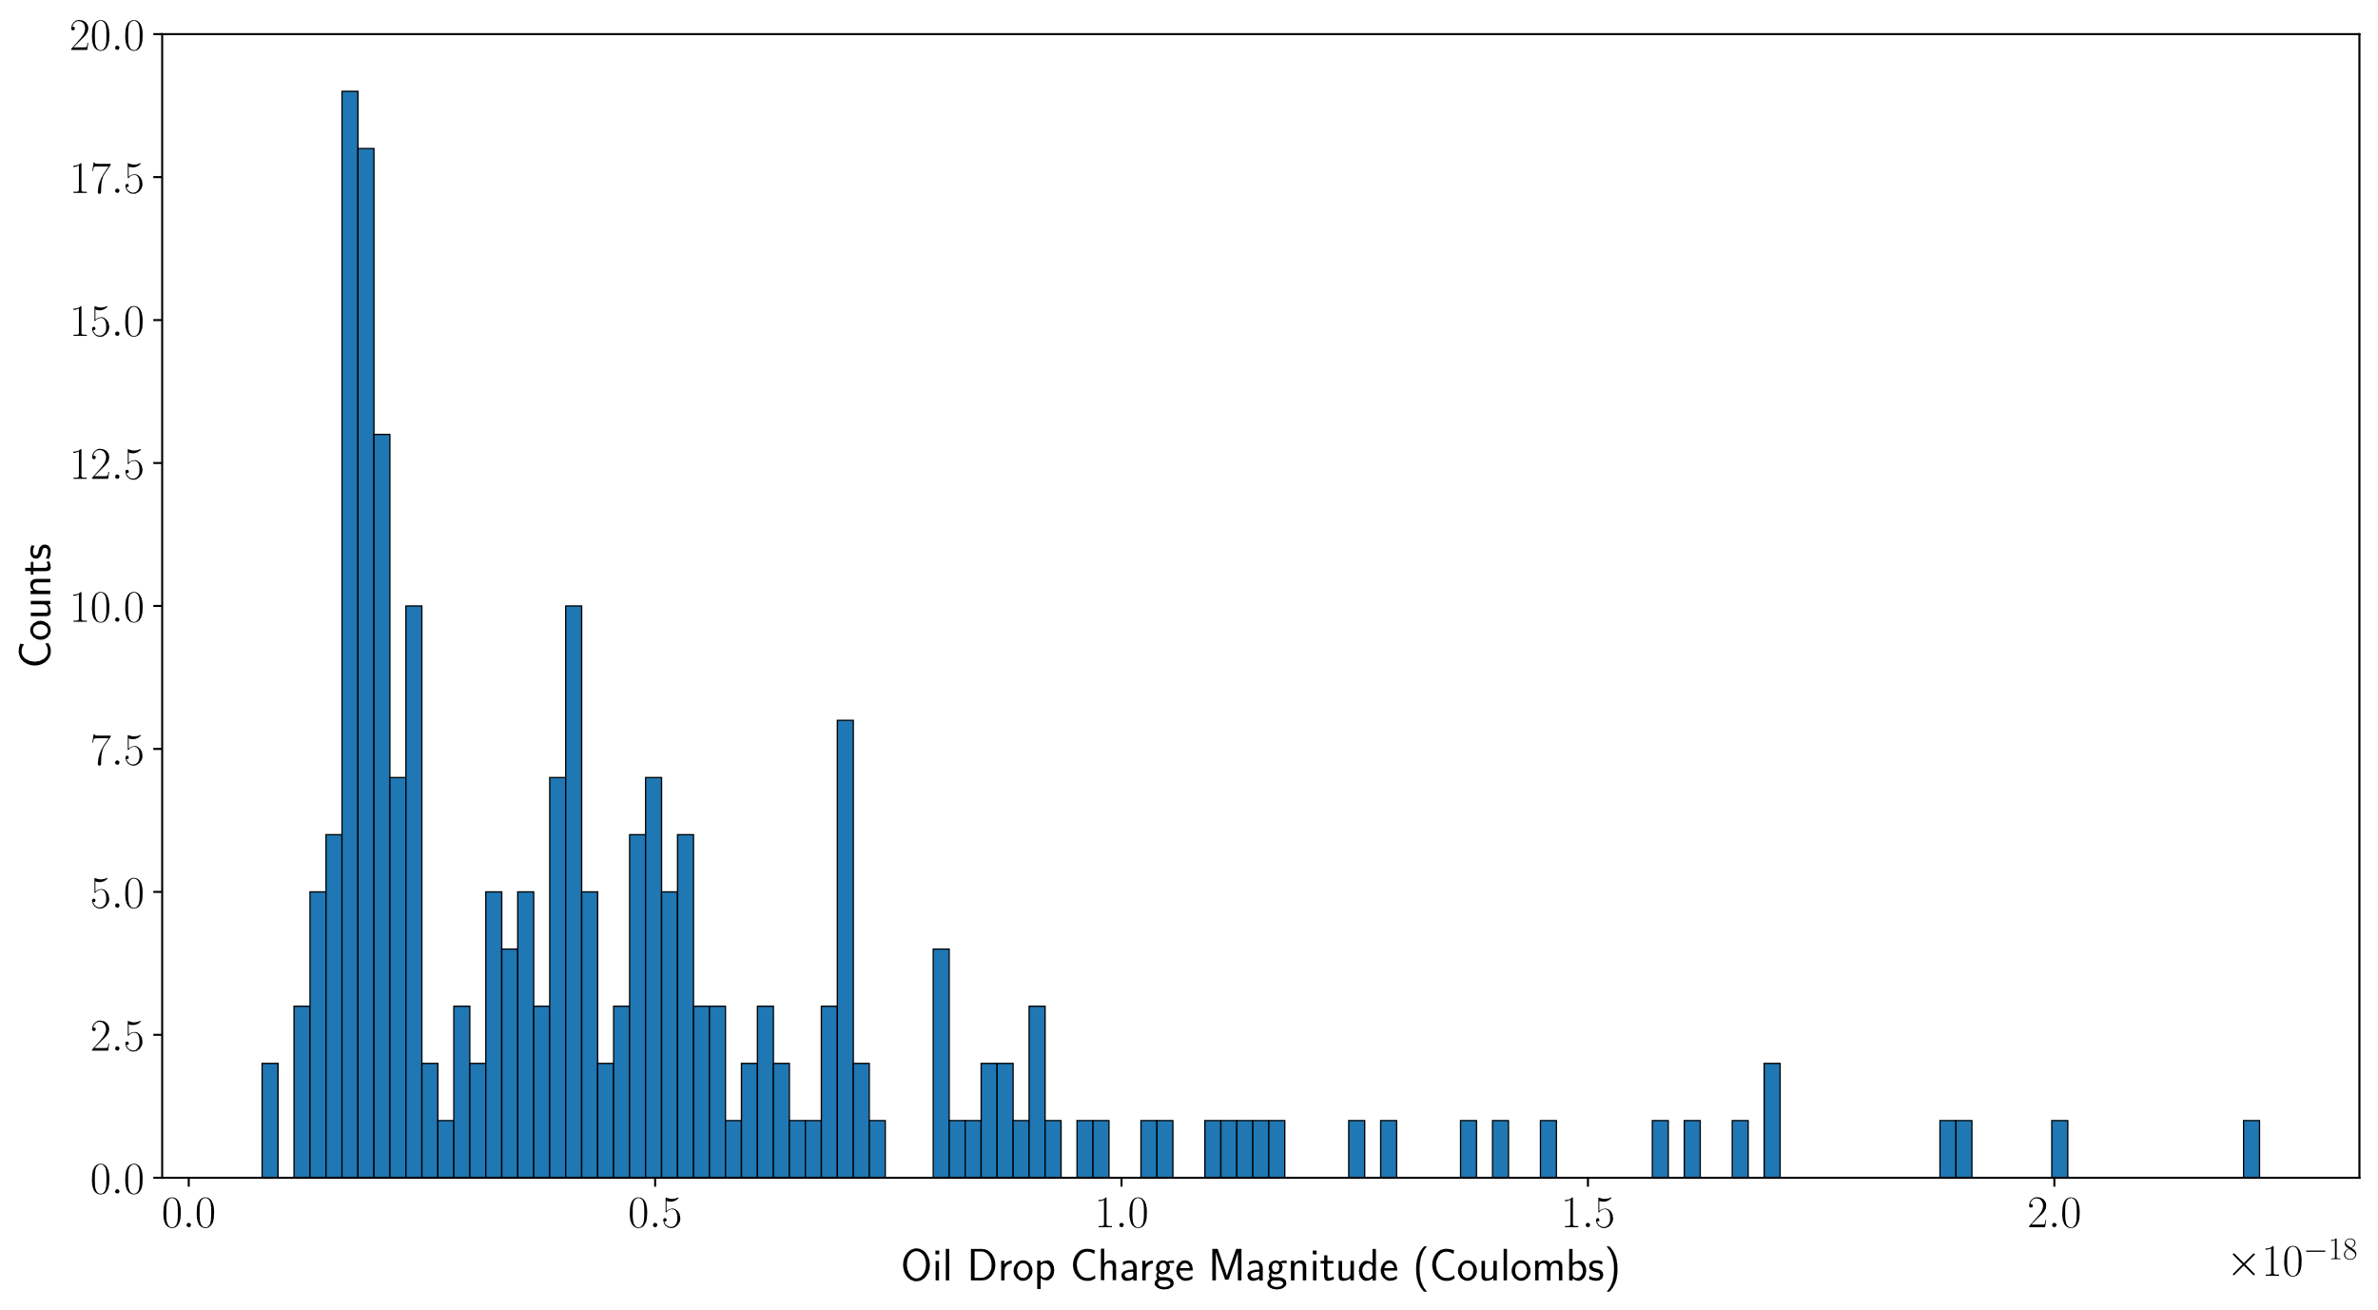
Notes:
Raw data of all recorded droplets

Slide 9
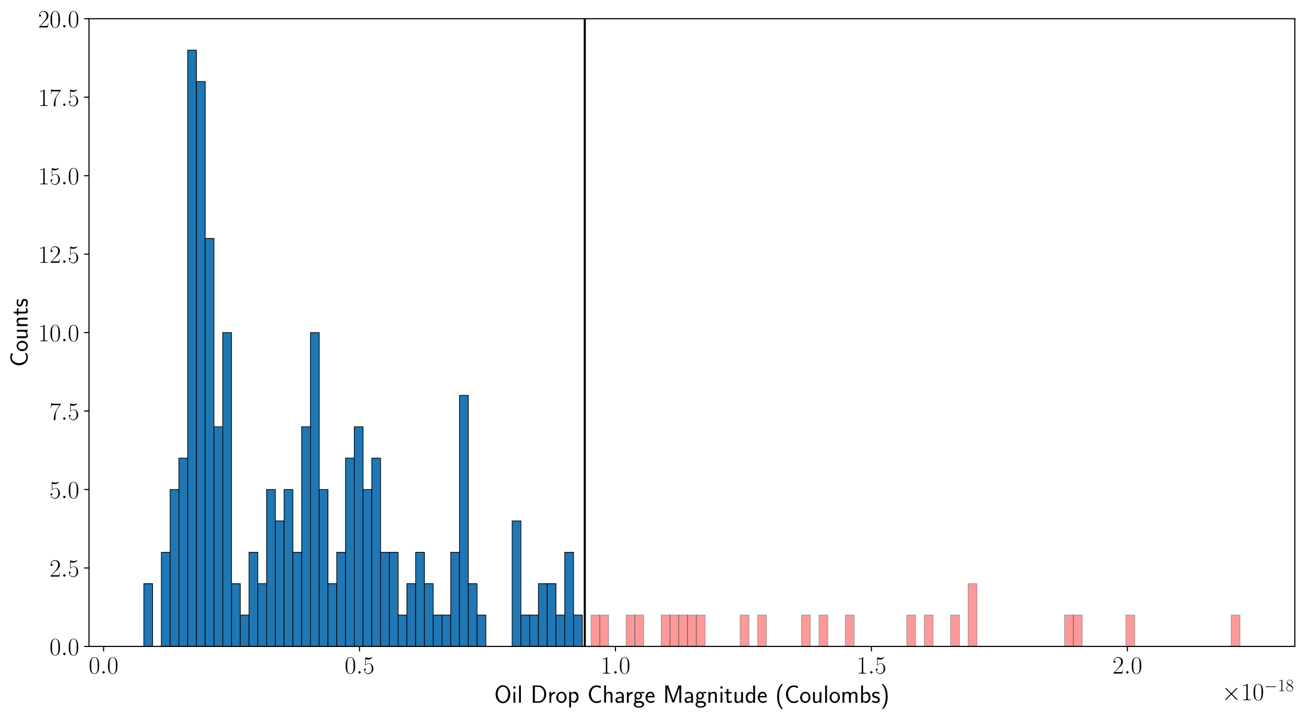
Notes:
Neglect higher charges as we want many observations of similar charges
Most charges higher than our cutoff have only 1 or 0 observations per bin

Slide 10
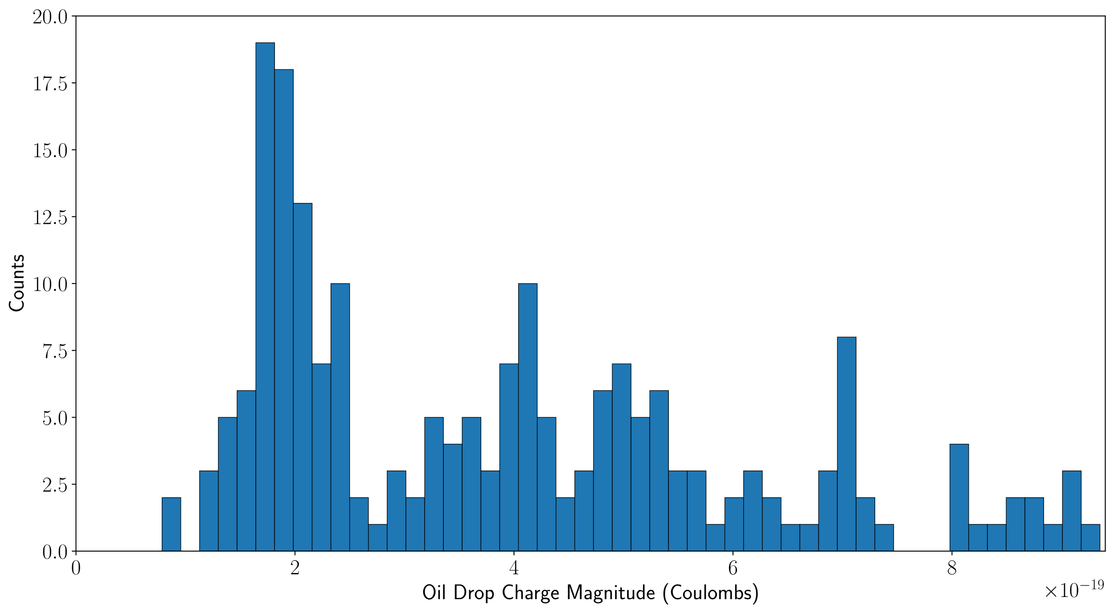
Notes:
Now focusing on our lower charged droplets
We visually inspect for bins of zero observations by lowering bin width which I won’t show here

Slide 11
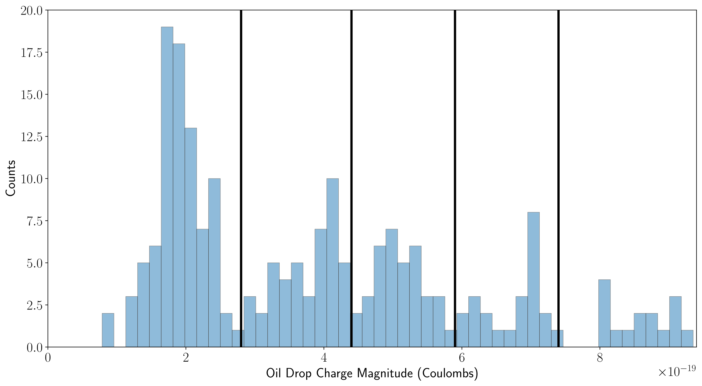
Notes:
Allows us to find four cutoffs shown in black
We hypothesize that we observe charges ranging from 1 to 5 fundamental charge quanta with divisions representing the boundary between quanta

Slide 12
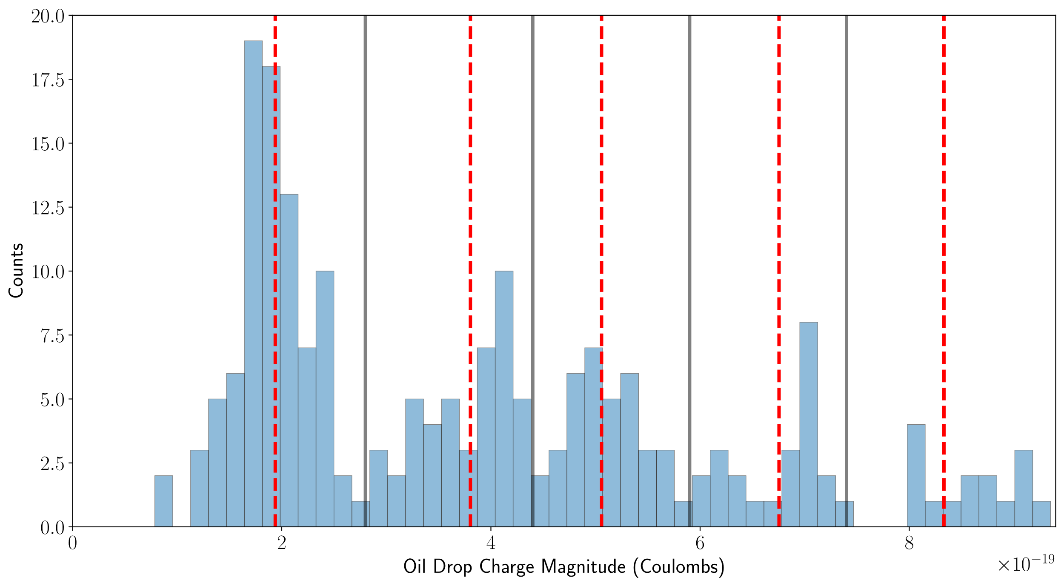
Notes:
We take the average and standard deviation of each quanta
Local means are shown by red dashed lines

Slide 13
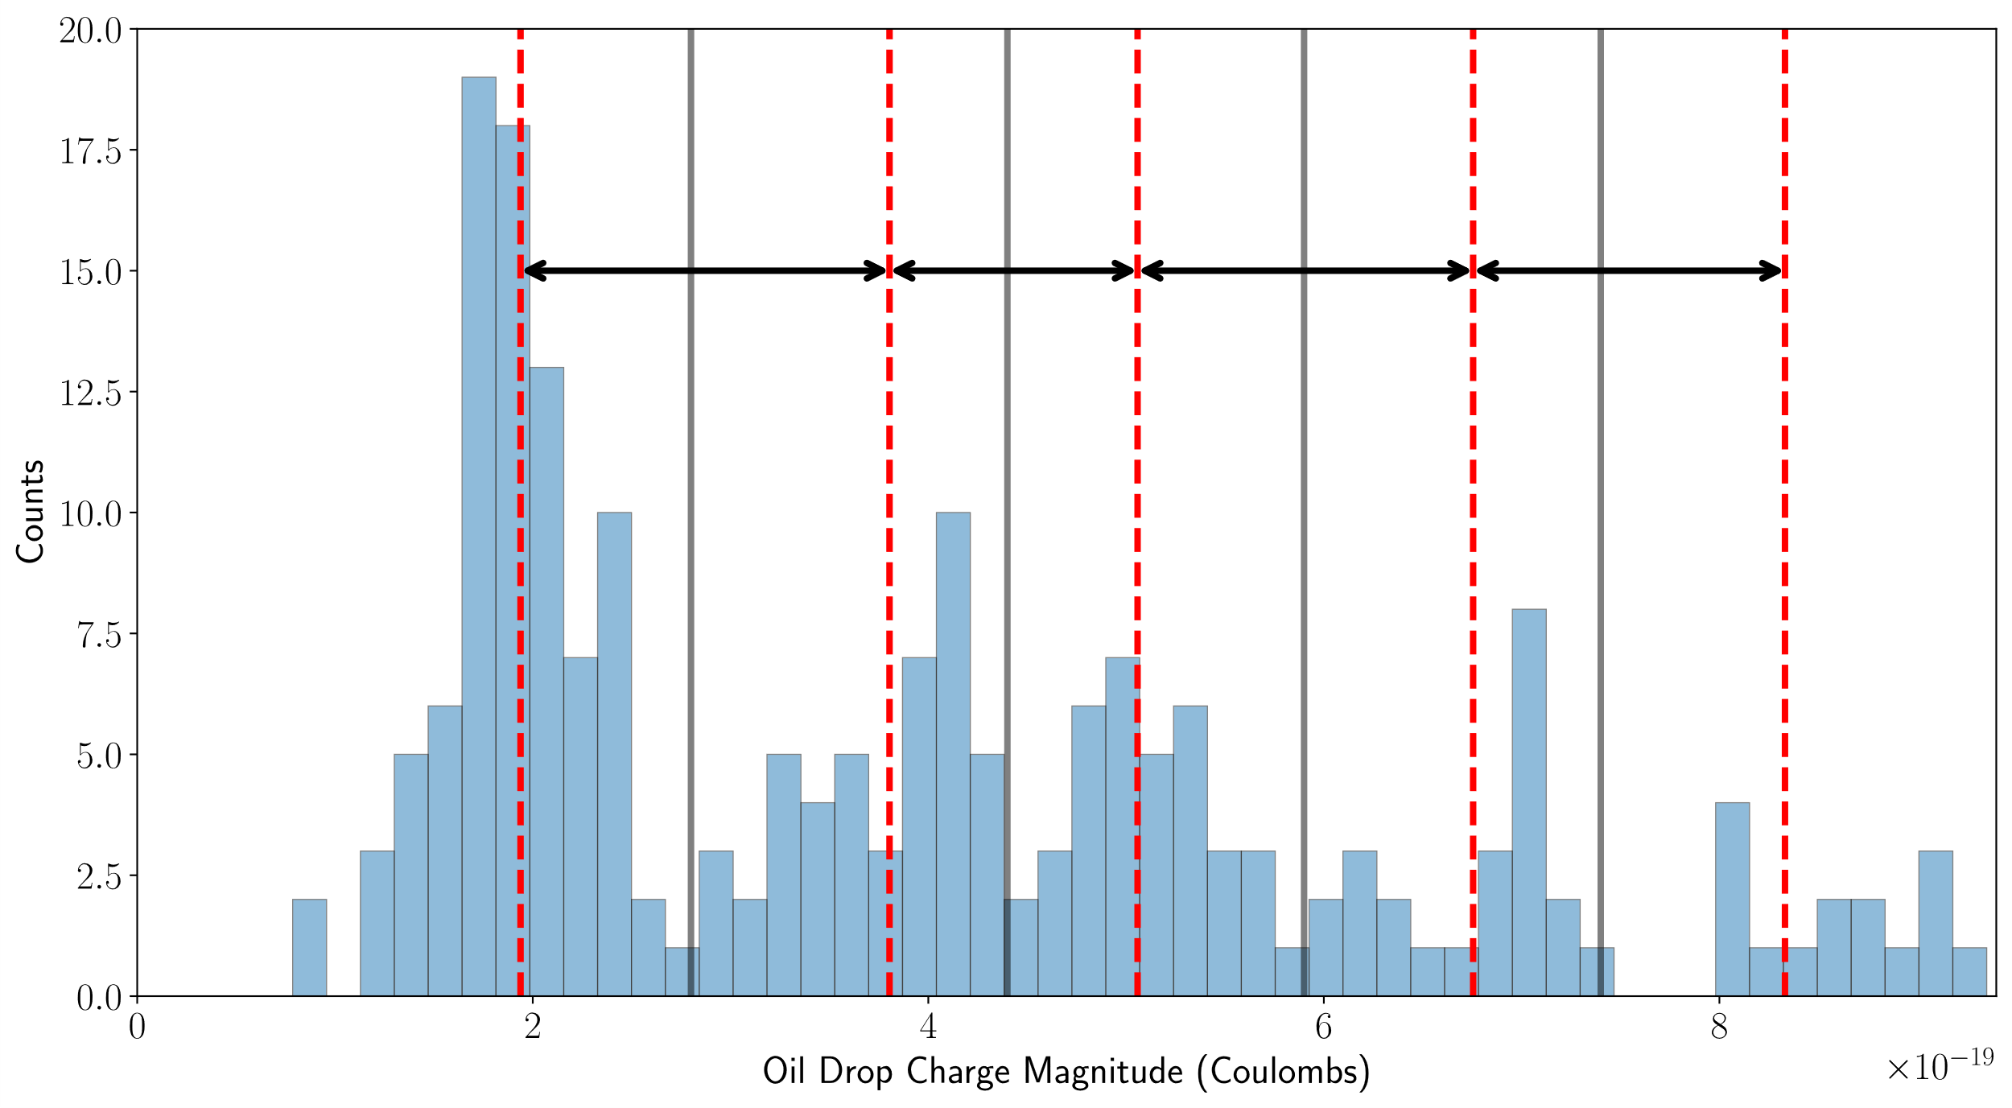
Notes:
Now we take the difference in means to represent four observations of the fundamental electric charge
By averaging these differences in means, we determine our estimate for the fundamental electric charge
SAY: statistical uncertainty is very small (order 10^-40) and we won’t discuss for the matter of time

Slide 14
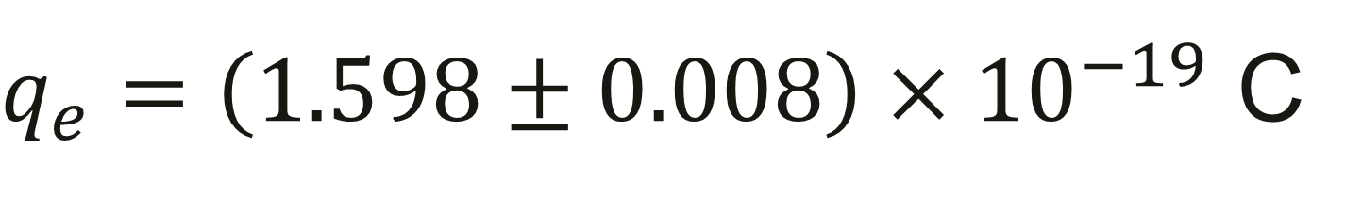
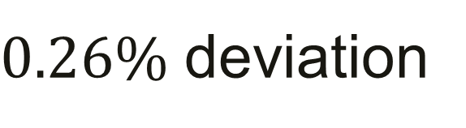
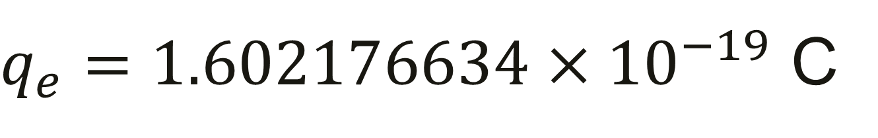
$q_{e}=\left(1.598±0.008\right)×{10}^{−19}$ C
$q_{e}=1.602176634×{10}^{−19}$ C
$0.26\%$ deviation
Notes:
After propagating our measurement error, we determine q_e as ___
q_e is defined as ___
Our result represents a 0.26% deviation from the defined value

Slide 15
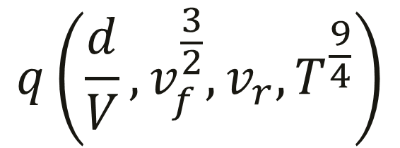
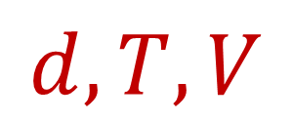

$F_{f}$ is complicated
$$q\left(\frac{d}{V},v_{f}^{\frac{3}{2}},v_{r},T^{\frac{9}{4}}\right)$$
$$d, T, V$$
Notes:
To propagate our uncertainty, we start by accepting that friction is complicated
Our real equation for q is therefore more complicated
After propagating our uncertainty in each input, we find that our primary uncertainty arose from our uncertainty in d, T, and V

Slide 16
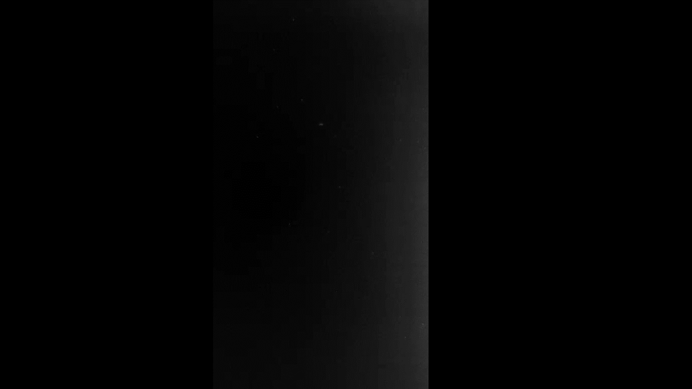
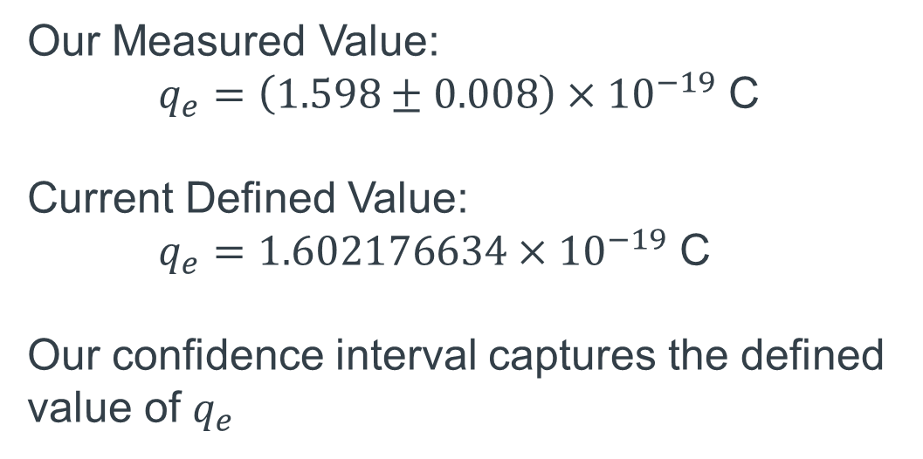
Key Conclusion
Our Measured Value:
$q_{e}=\left(1.598±0.008\right)×{10}^{−19}$ C
Current Defined Value:
$q_{e}=1.602176634×{10}^{−19}$ C
Our confidence interval captures the defined value of $q_{e}$
Notes:
Why oil? – Slower evaporation than water, allows for more precise measurements due to near constant mass

Slide 17
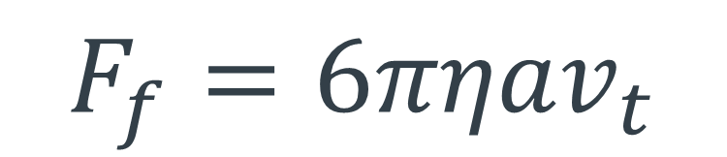
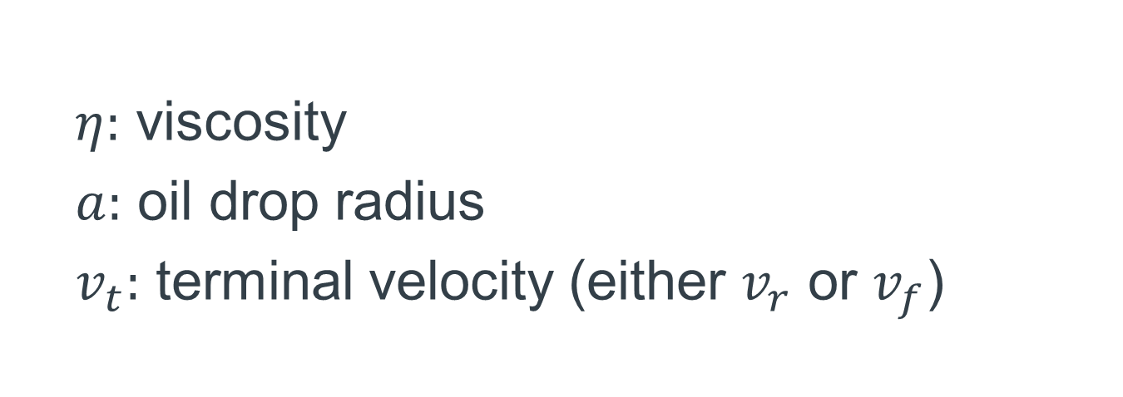
Friction
$$F_{f}=6πηav_{t}$$
$η:$ viscosity
$a:$ oil drop radius
$v_{t}:$ terminal velocity (either $v_{r}$ or $v_{f}$)

Slide 18
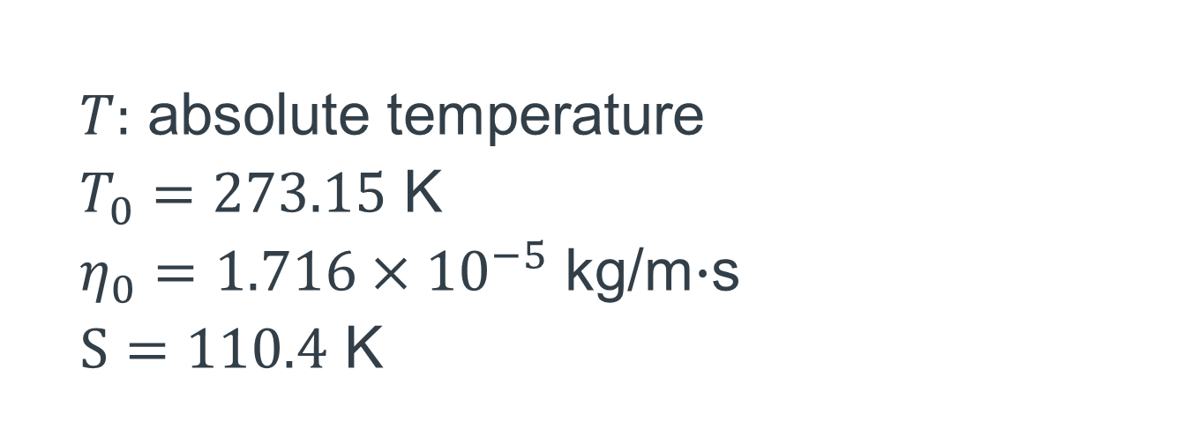
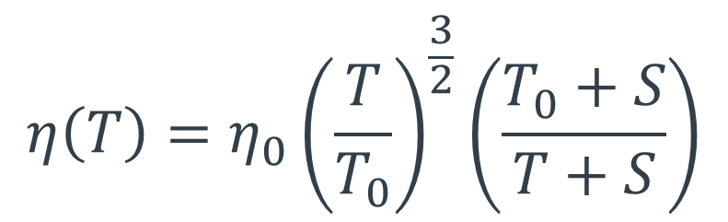
Viscosity
$$η\left(T\right)=η_{0}{\left(\frac{T}{T_{0}}\right)}^{\frac{3}{2}}\left(\frac{T_{0}+S}{T+S}\right)$$
$T:$ absolute temperature
$T_{0}=273.15$ K
$η_{0}=1.716×{10}^{−5}$ kg/m$∙$s
$S=110.4$ K
Notes:
Eta_0 and S are parameters for the mixture of Earth’s atmosphere under the approximation of majority nitrogen

Slide 19
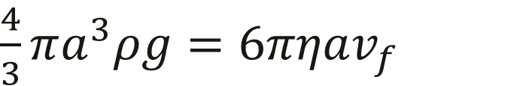
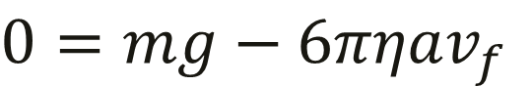
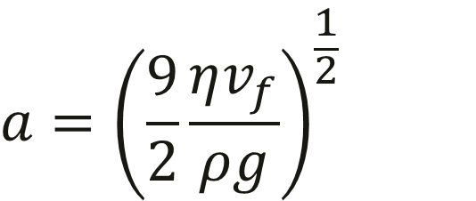
$$0=mg−6πηav_{f}$$
$$F_{f}$$
$\frac{4}{3}πa^{3}ρg=$ $6πηav_{f}$
$$v_{f}$$
$$a={\left(\frac{9}{2}\frac{ηv_{f}}{ρg}\right)}^{\frac{1}{2}}$$
$$F_{g}$$
$$+\hat{y}$$

Slide 20
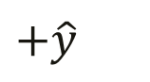
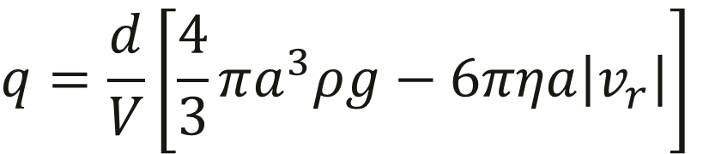
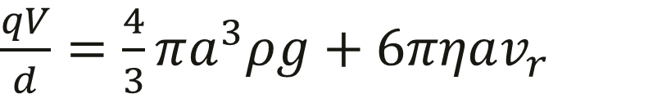
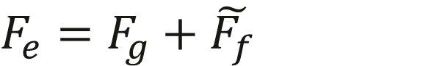
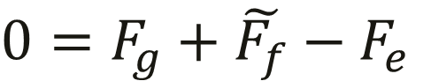
$$0=F_{g}+\tilde{F_{f}}−F_{e}$$
$$F_{e}=F_{g}+\tilde{F_{f}}$$
$$F_{e}$$
$$v_{r}$$
$\frac{qV}{d}=\frac{4}{3}πa^{3}ρg+6πηav_{r}$
$$F_{g}$$
$$q=\frac{d}{V}\left[\frac{4}{3}πa^{3}ρg−6πηa\left|v_{r}\right|\right]$$
$$+\hat{y}$$
$$\tilde{F_{f}}$$

Slide 21
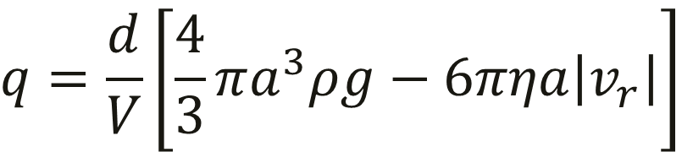
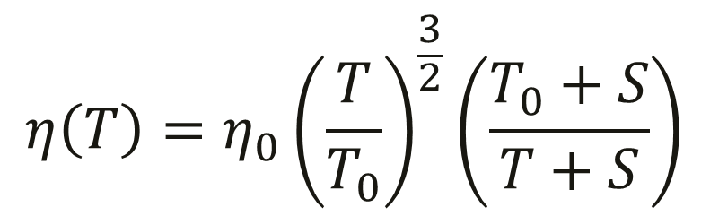
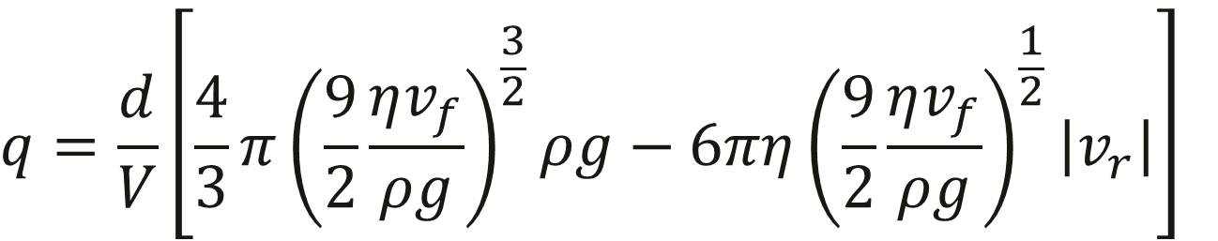
$$q=\frac{d}{V}\left[\frac{4}{3}πa^{3}ρg−6πηa\left|v_{r}\right|\right]$$
$$q=\frac{d}{V}\left[\frac{4}{3}π{\left(\frac{9}{2}\frac{ηv_{f}}{ρg}\right)}^{\frac{3}{2}}ρg−6πη{\left(\frac{9}{2}\frac{ηv_{f}}{ρg}\right)}^{\frac{1}{2}}\left|v_{r}\right|\right]$$
$$η\left(T\right)=η_{0}{\left(\frac{T}{T_{0}}\right)}^{\frac{3}{2}}\left(\frac{T_{0}+S}{T+S}\right)$$

Slide 22
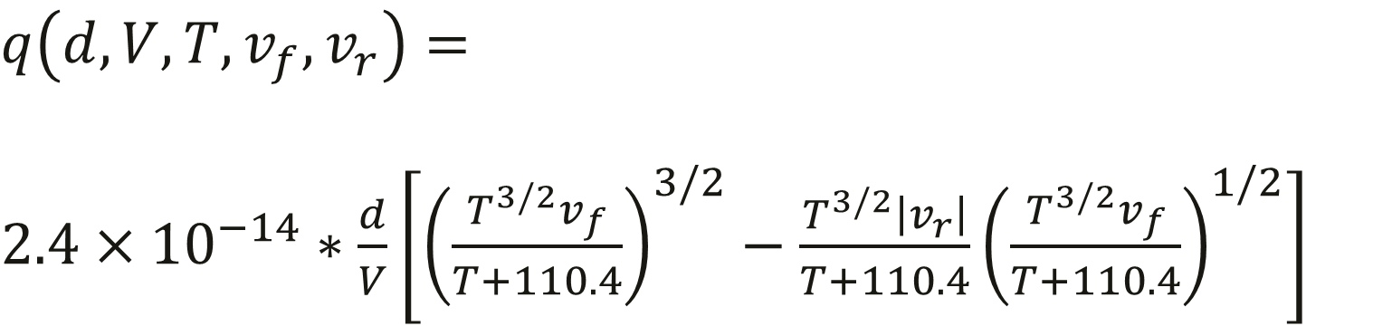
$$q\left(d,V,T,v_{f},v_{r}\right)=$$
$2.4×{10}^{−14}∗\frac{d}{V}\left[{\left(\frac{T^{3/2}v_{f}}{T+110.4}\right)}^{3/2}−\frac{T^{3/2}\left|v_{r}\right|}{T+110.4}{\left(\frac{T^{3/2}v_{f}}{T+110.4}\right)}^{1/2}\right]$
Notes:
Inserting Sutherland’s model with parameters
Inserting density rho = 886 kg/m^3

